Slide 1
Impact of a new minimum distance between wind turbines and settlements
Project by Group 5: Carsten Gawlas and Ulrike Lorenz
Seminar: GIS Analyses using Free and Open Source Software

Slide 2
Importance of the topic
Shift from fossil energies to renewable energies
Baden-Württemberg wants to produce 10% of the needed energy by wind turbine parks until 2020
New minimum distance to settlements
Research Questions:
How big will the area affected by these new requirements be? Do the new requirements have an significant impact at all?
Will the new minimum distance have an impact in impeding the goals for 2020 for Baden-Württemberg?
Which areas are best suitable for wind turbine parks in the research area?

Slide 3
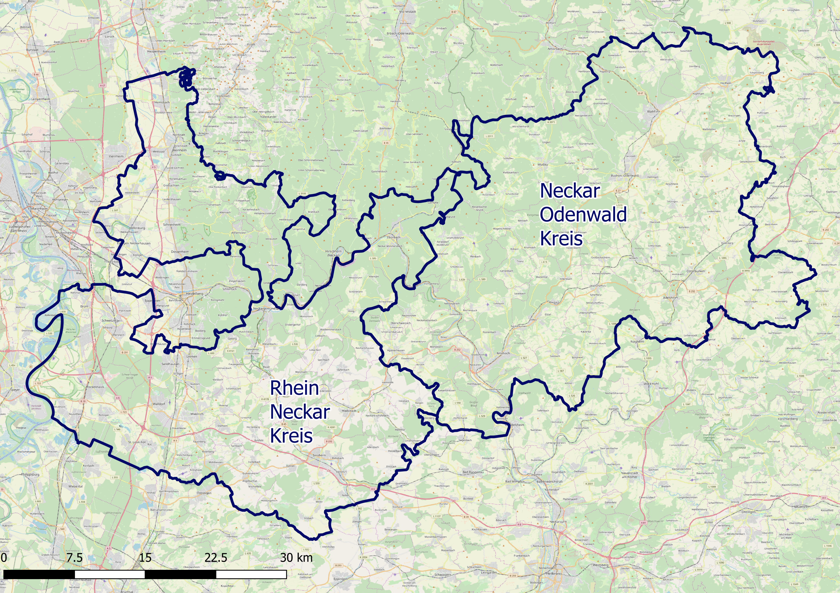
Region
Find Areas for windparks in Rhein-Neckar-Kreis and Neckar-Odenwald-Kreis

Slide 4
Important Data
Knock-out-criteria (regulated by law):
Areas that must be buffered: Airports, Farmyards, Industrial-/Commercial areas, powerlines, railways, settlements, streets, sports-/recreation areas
Gained from OSM
To evaluate the areas:
Slope gained from a DEM (SRTM-data)
Winddata (from Windatlas Baden-Württemberg and German Weather service)
Landuse (for example waterbodies gained from OSM)

Slide 5
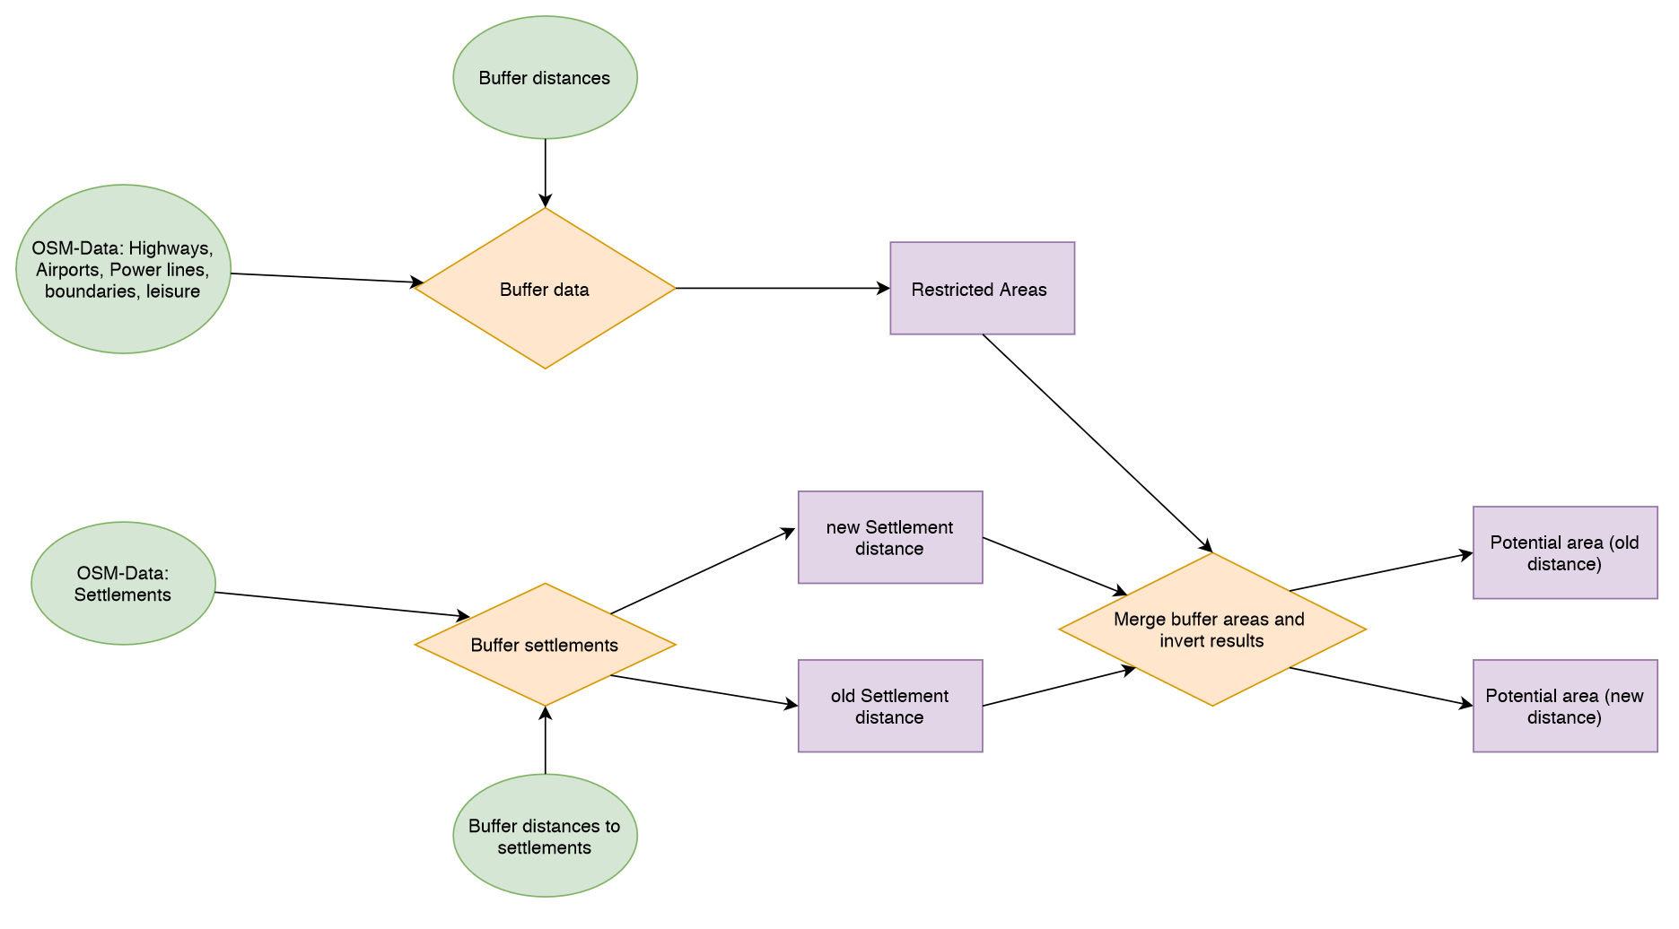
Data processing – knock-out-criteria

Slide 6
Data processing – knock-out-criteria
Table 1: Distances to objects (according to Bergmann & Höfle 2013)
Object | Distance
Settlements | 700 m (old) and 1000 m (new)
Farmyards | 500 m
Industrial- / Commercial areas | 300 m
Sports- / Recreation area | 300 m
Airports | 1500 m
Power lines | 150 m
Railways | 50 m
Streets | 30 – 100 m (depending on which kind of street it is)

Slide 7
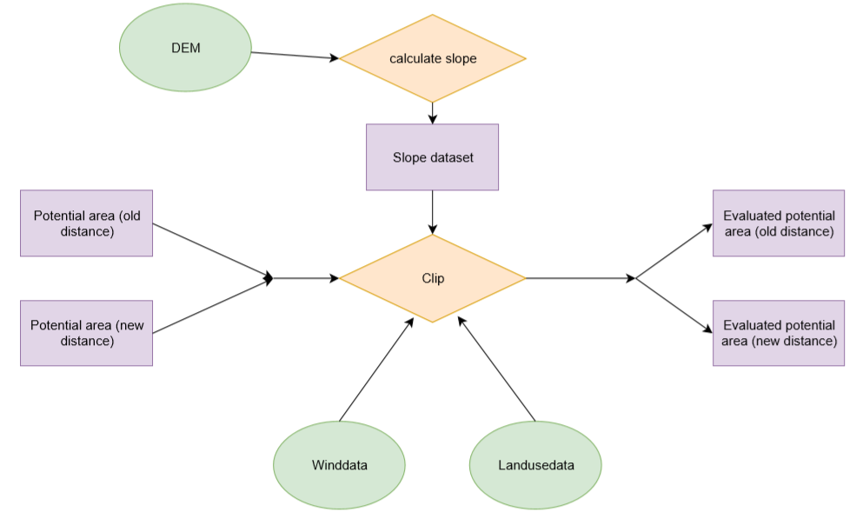
Data processing – evaluate areas

Slide 8
Data processing – evaluate areas
Weighting:
Winddata most important
Only small slope values are possible, high values are a knock-out-criteria
Landuse is necessary to decide how difficult it would be to build a wind turbine park (some landuses are not available for wind turbine parks)
Limitations:
No data about protected vegetation / animals
Communities have to allow wind turbine parks if the areas are not marked as place for a wind turbine park

Slide 9
First results
Karte einfügen

Slide 10
Problems
Actually processing with GRASS GIS was planned but:
Difficulties because of several projections
Problems while buffering
Import of Winddata was not possible (Dataformat NetCDF)
Union not possible because of data structure (attributes got lost under processing)

Slide 11
Repository
https://github.com/UlrikeLorenz/Final_Project_Group5

Slide 12
Sources
Bergmann, M. & Höfle, B. (2013): GIS-gestützte Standortplanung von Windenergieanlagen mit freien und amtlichen Geodaten. In: Strobl, J., Blaschke, T., Griesebner, G. & Zagel, B. (Hrsg.) (2013): Angewandte Geoinformatik 2013. Berlin/Offenbach (Herbert Wichmann Verlag / VDE Verlag GMBH).

